Slide 1

Social Media Analytics for Accident Reports
Pavan Achanta - pxa170230
Harichandana Yeleswaram –yxh180027
Sahithi Mallavarapu- sxm180108
Chakriramoj Sandireddy - cxs180003
Axat Chaudhari - akc170000

Slide 2



Architecture
Kibana - Geolocation
Visualization
Model
Twitter + Kafka
Geolocation
Ascii encode
Nltk – word tokenize
Nltk – stop words remover
Stemming
Tf-idf vectorizer

Slide 3
Models & Results
Multilayer Perceptron
Accuracy – 82.35 %
Multinomial Naïve Bayes
Accuracy – 90.4 %

Slide 4
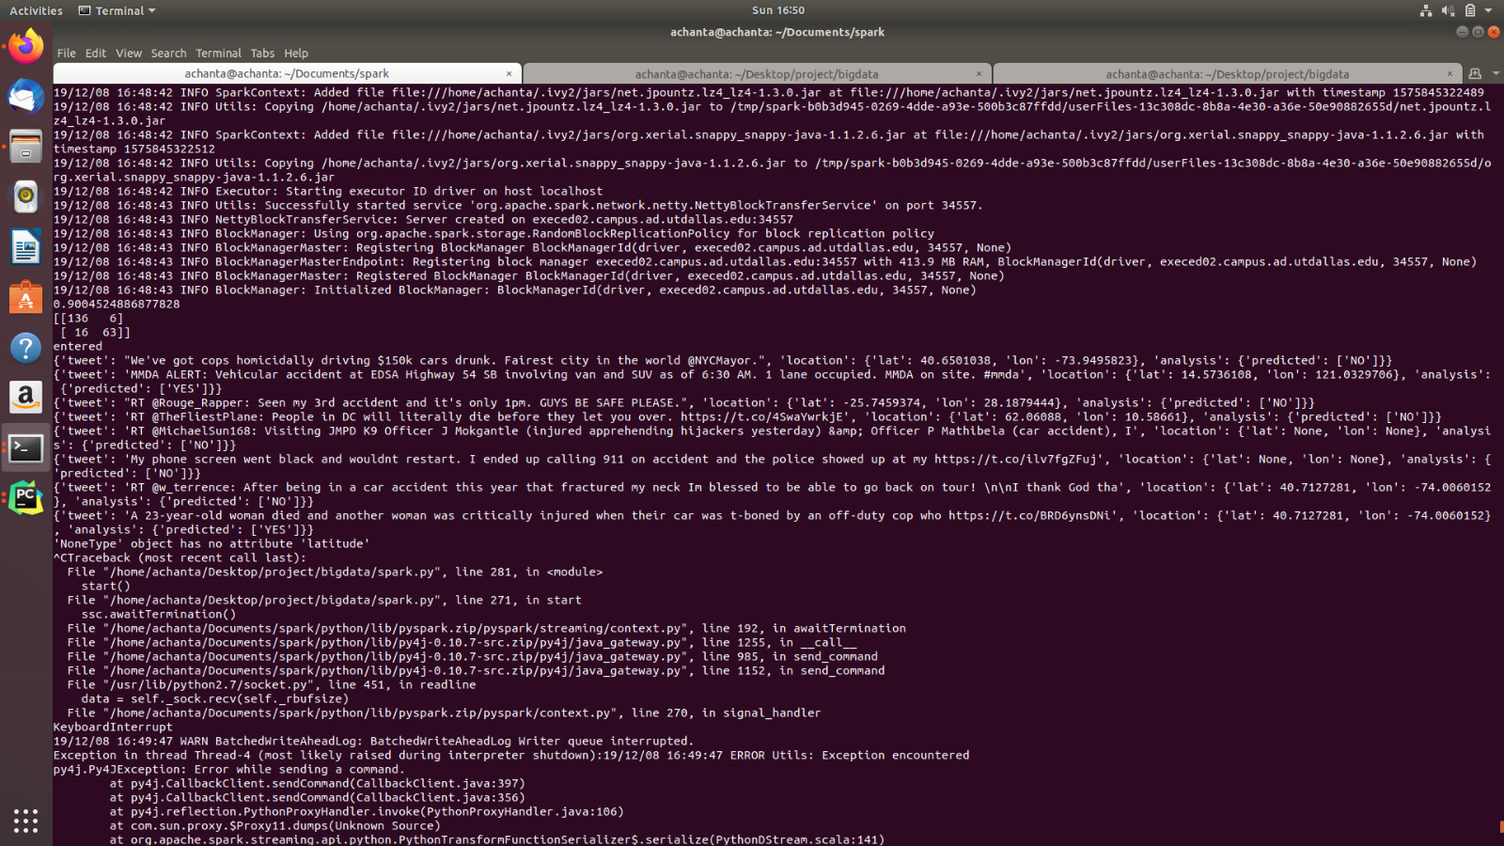
Models & Results

Slide 5
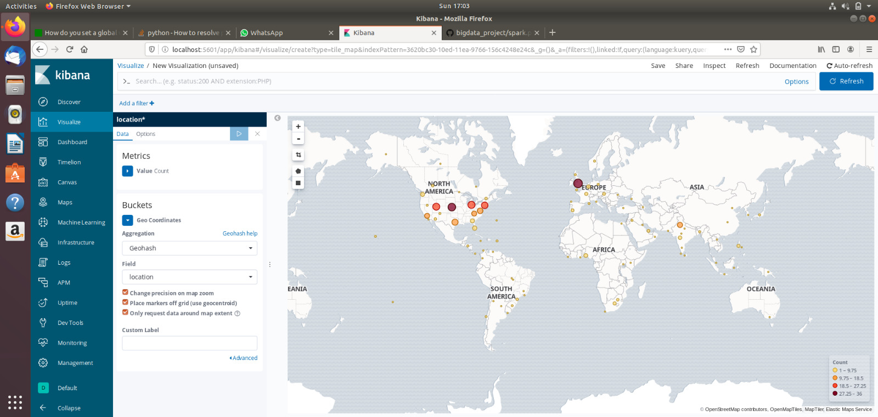
Kibana Visualization

Slide 6
Challenges
Collect training data
Real time data for testing is not a good representative of real accidents

Slide 7
Future Work
Predicting severity of the accidents
Extracting accident location from the tweet text

Slide 8
Contributions
Pavan Achanta - Model pipeline for train and test
Harichandana Yeleswaram - Model pipeline for train and test
Axat Chaudhari - Kafka setup and spark streaming
Sahithi Mallavarapu - Kibana visualization
Chakriramoj Sandireddy - Data collection and twitter streaming

Slide 9
THANK YOU

